Slide 1
Estructura
Product
Owner
Data
engineer
UX
Data
Scientist
ML Engineer
Data
Analysts
Scrum Master
Product
Improvement

Slide 2
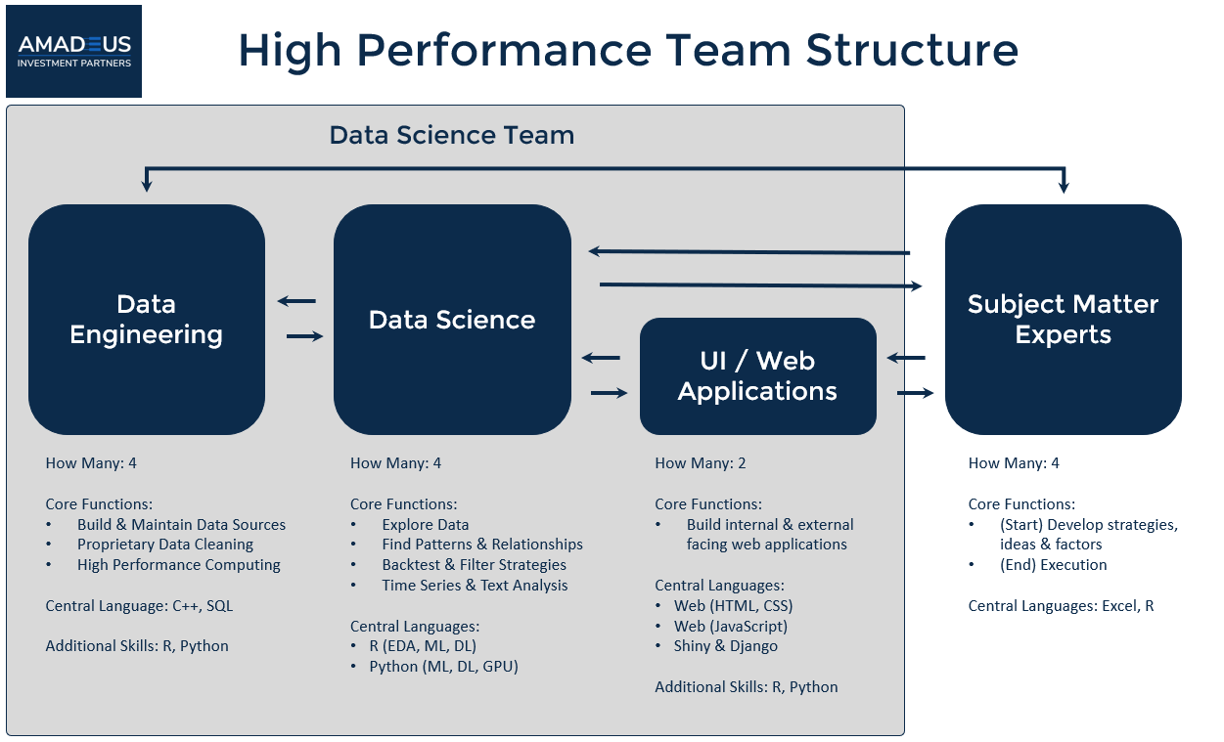
Célula de datos
Data Science Team
Data
Engineering
Data
Science
Subject Matter Experts
UI/ Web Applications

Slide 3
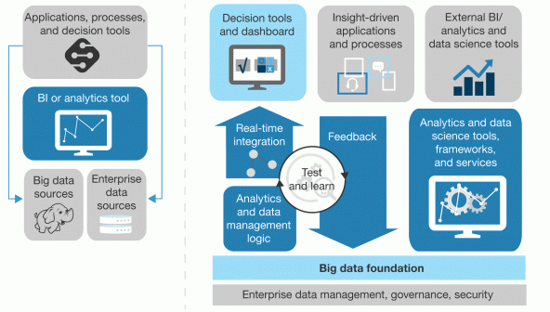
Data driven approach
Insinght driven approach
Applications, processes, and decision tools
Decision tools and dashboard
Insight-driven applications and processes
External BI/ analytics and data science tools
BI or analytics tool
Real-time
integration
Feedback
Analytics and data science tools, frameworks, and services
Test
and learn
Big data
sources
Enterprise
Data sources
Analytics
and data
management
logic
Big data foundation
Enterprise data management, governance, security
Descubrimos que, si bien el 74% de las empresas dicen que quieren estar "impulsadas por datos", solo el 29% dice que son buenas para conectar el análisis con la acción. Ese es el problema. Forrester

Slide 4
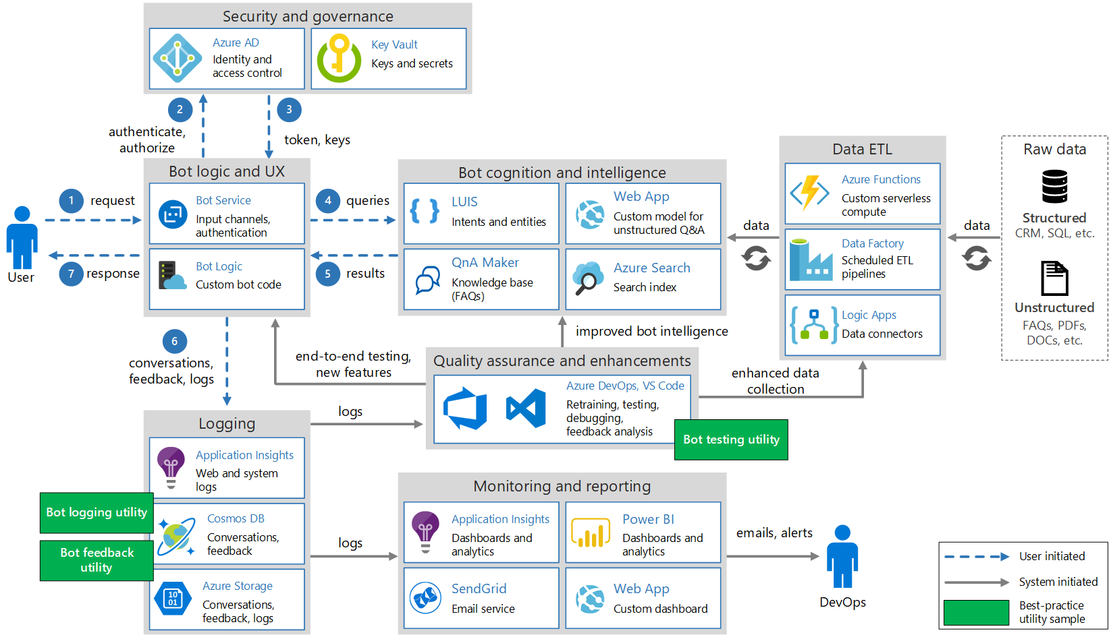
Security anf governance
2
3
Authenticate, authorize
Token, keys
Data ETL
Raw data
Bot cognitionand intelligence
Bot logic and UX
1
Request
4
Queries
Structured
CRM, SQL, etc
Data
Data
User
5
Results
7
Response
Unstructured
FAQs, PDFs, DOCs, etc.
6
Improved bot intelligence
Conversations, feedback, logs
End-to-end testing, new features
Enhanced data
collection
Quality assurance and enhancements
logs
Logging
Bot testing utility
Monitoring and reporting
Bot logging utility
User initiated
System initiated
Best-practice
Utility sample
logs
Emails, alerts
Bot feedback utility
DevOps

Slide 5
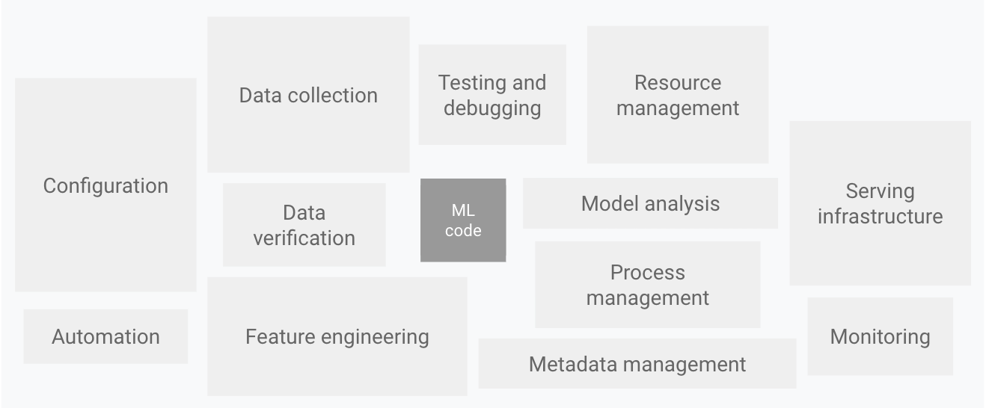
Data collection
Testing and debugging
Resource management
Configuration
Serving
infrastructure
ML
code
Model analysis
Data verification
Process management
Automation
Feature engineering
Monitoring
Metadata management

Slide 6
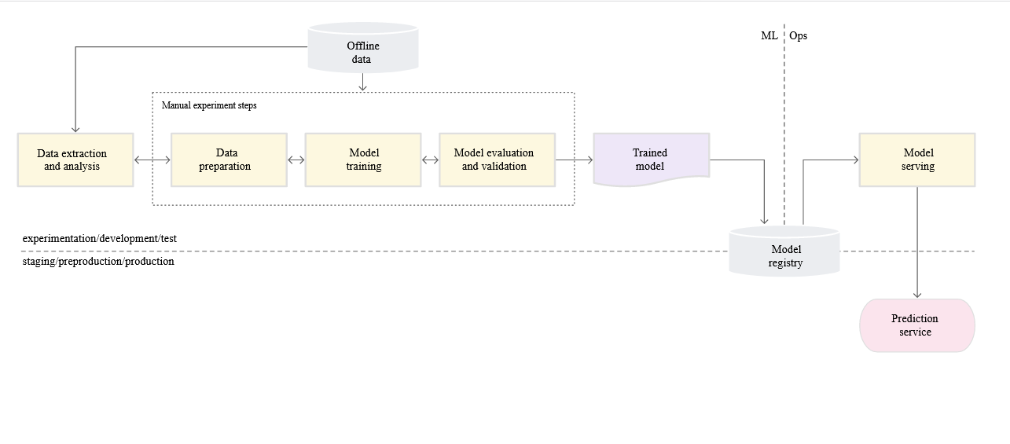
Offline data
ML Ops
Manual experiment steps
Data extraction and analysis
Data preparation
Model training
Model evaluation and validation
Trained model
Model serving
Model registry
Experimentation / development
Prediction
service
Staging / preproduction / production

